Slide 1
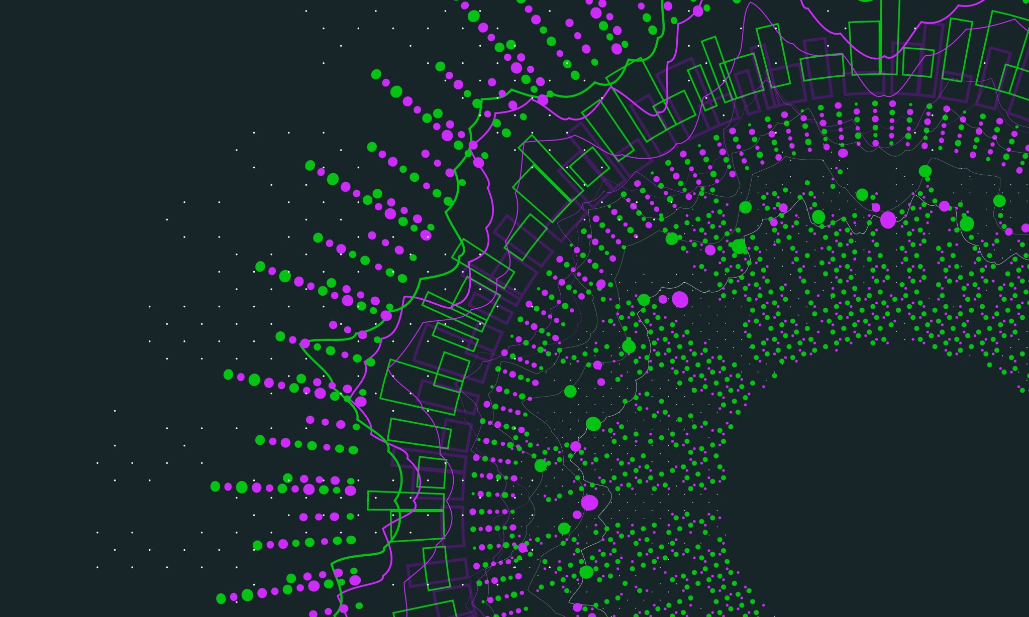
Dental Xray Anomaly Detection
Machine Learning and Neural Networks
Project 2

Slide 2
Introduction and Motivation
Diagnosis in the dental industry has long been different between professionals.
Since dentist sometimes have varied opinions on the issue, treatment plans can change, and patients do not have a standardized way to know how to proceed.
If AI models can accurately diagnose x-rays, patients and dentist will have a resource for standardized care.

Slide 3
Aims
Gather alabeled dental Xray dataset
01
Initial EDA to understand what is possible with the dataset
02
Train open source SOTA CV models like Yolo-v8 (free for educational usage)
03
Compare performance and metrics
04
Analyze if this is viable for market usage
05

Slide 4
Background Research
Teeth and prostheses detection in dental panoramic X-rays using CNN-based object detector and a priori knowledge-based algorithm
Detection of Dental Diseases through X-Ray Images Using Neural Search Architecture Network
Object detection on dental x-ray images using deep learning method
Detection of Covid-19 From Chest X-ray Images Using Artificial Intelligence: An Early Review
AI-Dentify: deep learning for proximal caries detection on bitewing x-ray - HUNT4 Oral Health Study

Slide 5
Teeth and prostheses detection in dental panoramic X-rays using CNN-based object detector and a priori knowledge-based algorithm
incorporates prosthesis information and considers complete restorations such as dental implants and dentures of fixed bridges during the teeth enumeration process, which follows the universal tooth numbering system. automating dental charting processes.
The study utilizes a dataset of 3138 radiographs, of which 2553 images contain prostheses, to build a robust model.
leveraging two separate CNN-based object detectors, namely YOLOv7, for detecting teeth and prostheses, alongside an optimization algorithm to refine the outcomes.

Slide 6
Detection of Dental Diseases through X-Ray Images Using Neural Search Architecture Network
For panoramic radiographs, this paper proposes a convolutional neural network (CNN) that can do multitask classification by classifying the X-ray images into three classes: cavity, filling, and implant.
NASNet model
The model has achieved an accuracy of greater than 96%.

Slide 7
Object detection on dental x-ray images using deep learning method
a model will be developed to be able to detect objects in the dental panoramic x-ray images using Mask R-CNN
The object to be detected is a restoration object. Dental restoration is a treatment to repair cavities or damaged teeth, as well as dental repair treatment after endodontic treatment, to restore the normal function and appearance of teeth
With the automatic detection of objects on panoramic x-rays, it is expected save time, improve the quality of dental care, and the quality of diagnosis made by dentists.

Slide 8
Detection of Covid-19 From Chest X-ray Images Using Artificial Intelligence: An Early Review
Several deep learning architecture are deployed for the detection of COVID-19 such as ResNet, Inception, Googlenet etc
how the system realize that the pneumonia detection in the chest x-ray is caused by COVID-19
The proposed AI based approaches in the literature for detection of COVID-19 shows promising results such VGG19 with 98% of accuracy, ResNET with 96%, ResNet50 with 95% of accuracy, and InceptionV3 with 96%.
The databases used in most of cases is about 50-100 x-ray images both infected subject with COVID-19 and normal subjects too.
All the proposed approaches used a binary classification techniques.

Slide 9
AI-Dentify: deep learning for proximal caries detection on bitewing x-ray - HUNT4 Oral Health Study
A dataset of 13,887 bitewings from the HUNT4 Oral Health Study were annotated individually by six different experts.
And used to train three different object detection deep-learning architectures: RetinaNet (ResNet50), YOLOv5 (M size), and EfficientDet (D0 and D1 sizes).
A consensus dataset of 197 images, annotated jointly by the same six dental clinicians, was used for evaluation.
A five-fold cross validation scheme was used to evaluate the performance of the AI models.

Slide 10
Gap Analysis
Use object detection or instance segmentation models
Annotate Data by Dentists for specific purpose with good review process
Get a severity level for a diagnosed issues
Treatment recommendations

Slide 11
Evaluation / Expected Outcome
Annotated dataset of 5000 x-rays of cavities
- 2,500 panoramic x-rays
- 2,500 intraoral x-rays
Ethical and privacy guidelines in place for use of dataset
Create converter functions for COCO and other formats for object detection and instance segmentation
Train opensource SOTA models like Yolo-v8 and Mask RCNN
Compare Results between models

